Slide 1
Software Engineering
Topic 1
Introduction to Software Engineering Unit
Notes:
NCC Education - Title Master

Slide 2
Why Software Engineering?
Role of software in Modern Society
Quality and Reliability of software
Efficiency and Cost-Effectiveness of software development procedure
Innovation and Creativity of software
Project Management and Collaboration
Scalability and Adaptability in software development
Security and Privacy in software
Ethical Considerations in software development
Career opportunities

Slide 3
Unit Aims
The aims of this unit are:
To provide students with a comprehensive understanding of the fundamental principles, techniques, and practices in software engineering.
To equip students with the knowledge and skills necessary to effectively design, develop, test, deploy, and maintain high-quality software systems.
To understand the key concepts and procedures in software engineering including:
concepts of software and software engineering
Software development life cycle and each of its stages
software quality metrics and measurements
privacy and security in software engineering
project management in software development

Slide 4
Unit Outcomes
Explain the need for an engineering approach to software development
Explain software engineering key practices and principles
Create models of software data and processes using object-oriented modelling approaches
Describe and evaluate tools and techniques to enhance productivity and quality of software

Slide 5
The Unit Roadmap
Topic 1: Introduction to Software Engineering Unit
Topic 2: Introduction to Software Engineering Key Practices and Principles
Topic 3: Software Development Life Cycle Models
Topic 4: Requirement Engineering
Topic 5: System Modelling & Design
Topic 6: Software Implementation & Testing
Topic 7: System Dependency & Security
Topic 8: Project Management
Topic 9: Mini Project 1
Topic 10: Mini Project 2
Topic 11: Mini Project 3
Topic 12: Mini Project 4

Slide 6
Unit Assessment Methods
100 % Minin Project + Report

Slide 7
Scope and Coverage
This topic will cover:
Unit Overview
Session Overview
Software definitions
Software characteristics
Software application domains
Software crisis and issues in software development
Software Engineering
Software Quality Measurement & Factors
Software Engineering Ethics
Notes:
NCC Education - Slide Master

Slide 8
Learning Outcomes
By the end of this topic students will be able to:
Discuss the nature of software
Explain the motivation for the development of software engineering
Describe the cost of software maintenance
Explain software quality
Discuss software engineering ethics

Slide 9

What is a software?
“Software is the programs and programming support necessary to put a computer through its assigned tasks, as distinguished from the actual machine” (New Webster’s Dictionary, 1981)
“Software comprises programs, data, (executable code) and instructions that enable computers to perform tasks (source code).

Slide 10
Software Functions
1. Data processing and manipulation
2. Calculation and mathematical operations
3. User interface interactions and input/output handling
4. File management and storage
5. Networking and communication with other software or hardware
6. Security and access control
7. Error handling and debugging
8. Task scheduling and automation
9. Database management and querying
10. Graphics rendering and multimedia processing

Slide 11
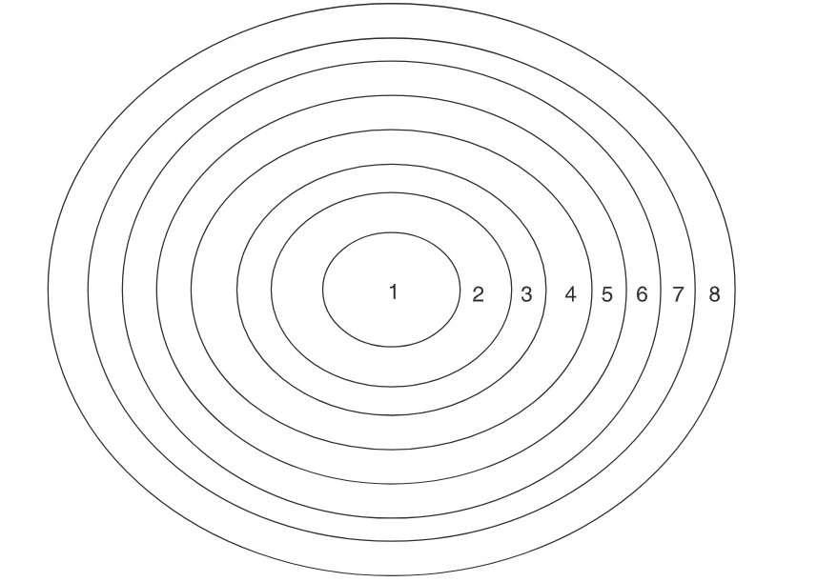





Software Application Levels
Hardware Logic (Machine Micrologic)
Low-level logic implemented directly in hardware components, such as processors, memory units, and input/output devices.
System Software (Supervisor or Executive, Operating Systems, Programming Language Translators, Utility Programs)
Operating system, programming language, utility programs
Application Software (Inquiry, File, database software, Programming and Assembly Languages and Programs)
Inquiry software, file & database software
End-user Software (Fourth-Generation Languages and User Programs such as SPSS, SQL, etc)
User Programs such as SPSS, SQL, etc

Slide 12
Software Characteristics
Complexity:
Software is developed, not manufactured
No two parts of a software product are alike
Defining user requirements, design and development of software are difficult since it is not a tangible object
Time and efforts estimation are hard for software development
Conformity:
Software products are custom-built and so unique.
Changeability:
Software needs many modification, particularly with user requirement changing.
Invisibility:
Software is a virtual object, not physical

Slide 13
Software Crisis
Requirements Complexity
Schedule Delays
Cost Overruns
Quality Issues
Technological Challenges
Management Problems
Maintenance Issues
Notes:
- Requirements Complexity: Difficulty in accurately capturing and defining user needs and system requirements.
- Schedule Delays: Projects frequently exceed planned timelines due to underestimated development efforts.
- Cost Overruns: Budgets often balloon as a result of extended development cycles and unforeseen challenges.
- Quality Issues: Software may suffer from defects, bugs, and inadequate testing, leading to subpar performance and user dissatisfaction.
- Technological Challenges: Adapting to rapidly evolving technologies can pose hurdles in development and implementation.
-Management Problems: Inadequate project management practices contribute to miscommunication, scope creep, and resource misallocation.
-Maintenance Issues: addressing bugs, implementing updates, and managing technical debt.

Slide 14
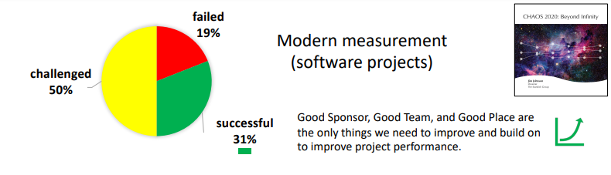
Software Crisis Report
Good Place
Principles for a Good Place are:
The Decision Latency Principle
The Emotional Maturity Principle
The Communication Principle
The User Involvement Principle
https://hennyportman.files.wordpress.com/2021/01/project-success-qrc-standish-group-chaos-report-2020.pdf

Slide 15
Issues of Software Maintenance
Limited understanding: Finding errors in large software systems is challengeable by engineers who have not done the development
High cost: Cost of full testing is high
Changes impact analysis: To find out of any impact on other features of software
Maintainability: Some software is not adoptable to changes
Managemental issues: No return on investment

Slide 16
Computer Disasters in History
Ariane 5 Disaster
In 1996, Europe's newest and unmanned satellite-launching rocket, the Ariane 5, was intentionally blown up just seconds after taking off on its maiden flight from Kourou, French Guiana.
The fault was quickly identified as a software bug in the rocket’s Inertial Reference System. The rocket used this system to determine whether it was pointing up or down, which is formally known as the horizontal bias, or informally as a BH value.
Airbus 2006 Disaster
The Airbus issue of 2006 highlighted a problem many companies can have with software: what happens when one program doesn't talk to another. In this case, the problem was caused by two halves of the same program, the CATIA software that is used to design and assembly of one of the world's largest aircraft, the Airbus A380.

Slide 17
Short Activity
In groups of 2 to 3, try to identify failure factors in software development .
Compare and discuss your findings with other groups.

Slide 18
Checkpoint Summary
Software is the detailed instructions that execute specific tasks and control the operation of a computer system.
Software applications are categories into 4 sub-categories: Hardware Logic, System Software, Application Software, and End User Software.
Software characterise such as complexity, conformality, changeability, and invisibility may cause many challenges in software development.
A systematic and controlled software development strategy from beginning of software construction stage can reduce many challenges in software development.
Software engineering frameworks can help developers to overcome above challenges in a strategic and systematic way.

Slide 19
Software Quality
Quality definitions:
“ISO definition: “the totality of features and characteristics of a product or service that bear on its ability to satisfy specified or implied needs” (ISO 9000:2015)
Software Quality definition:
“the degree to which a software product meets established requirement; however, quality depends upon the degree to which those established requirements accurately represent stakeholder needs, wants and expectation. “ (IEEE P730/D8)

Slide 20
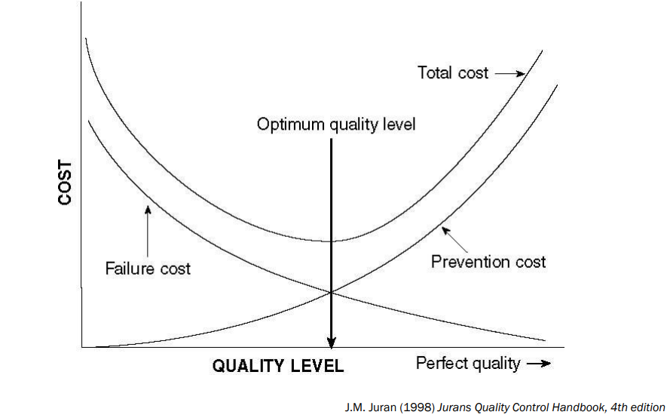
Cost of Quality

Slide 21
Software Quality Measurement
How to say a piece of software is “good enough”?
define criteria (error free, size, user satisfaction, etc)
measure metrics (quality of code, security of codes, meeting user requirements, etc)
use methods ( Lines of Code (LOC), ISO standard, Software Inspection, Peer review, Programming in pairs, testing, etc)

Slide 22
LOC (Lines of Code)
Industry Average: “about 15-50 errors per 1000 lines of delivered code”
Microsoft Applications: “about 10-20 defects per 1000 lines (Moore 1992)
Cleanroom development: “ a technique that has been able to achieve rates as low as 3 defects per 1000 lines of codes” (Cobb and Mills 1990)

Slide 23
Other Methods
Peer Review: walkthrough and inspection by two or three colleagues, often from different project team
Software Inspection (rigorous form of peer review): “ a formal evaluation technique in which software requirements, design or code are examined in detail by a person or group other than author to detect faults…” (ANSI/IEEE standard 729-1983)
Programming in pairs: both programmers sharing a single workstation, engaging actively in coding and error checking

Slide 24
Software Ethics
Software engineers are expected to share a commitment to software quality as part of their culture known as Software Ethics.
IEEE Computer Society and the ACM have developed a code of ethics and professional practice known as “Software Engineering Codes of Ethics” (ACM 1997).

Slide 25
Software Engineering Code of Ethics
Principle 1: Product
Software engineers shall, insofar as possible, assure that the software on which they work is useful and of acceptable quality to the public, the employer, the client, and the user, completed on time and at reasonable cost, and free of error.
Principle 2: Public
Software engineering shall, in their professional role, act only in ways consistent with the public safety, health and welfare.
Principle 3: Judgment
Software engineers shall, insofar as possible and consistent with Principle 2, protect both the independence of their professional judgment and their reputation for such judgment.
Principle 4: Client & Employer
Software engineers shall, consistent with the public health, safety, and welfare, always act in professional matters as faithful agents and trustees of their client or employer.

Slide 26
Software Engineering Code of Ethics
Principle 5: Management
A software engineer in a management or leadership capacity shall act fairly and shall enable and encourage those who they lead to meet their own and collective obligations, including those under this code.
Principle 6: Profession
Software engineers shall, in all professional matters, advance both the integrity and reputation of their profession as is consistent with public health, safety, and welfare.
Principle 7: Colleagues
Software engineers shall treat all those with whom they work fairly and take positive steps to support collegial activities.
Principle 8: Self
Software engineers shall, throughout their careers, strive to enhance their own abilities to practice their profession as it should be practiced.

Slide 27
Software Engineering Definitions
There are many definitions for software engineering:
“The establishment and use of sound engineering principles in order to obtain economically software that is reliable and works on real machines” (Bauer 1972)
“Software engineering is a discipline that adopts engineering approaches such as established methodologies, process, tools, standards, organisation methods, management methods, quality assurance systems, and the like to develop large-scale software with high productivity, low cost, controllable quality, and measurement development schedules.” (Wang and King 2000)
Software engineering is a set of three key elements (Pressman 1992):
method: provide the technical “how to’s” for building software
tools: provide automated or semi-automated support for methods
procedures: define the sequence of applying the methods, the deliverables, the controls, and the milestones.

Slide 28
Software Engineering
Software engineering is not only concerned with the technical development of product.
It also includes activities such as project management methods.
It is mostly concerning to get the result withing required quality, in the defined schedule and budget.
It is about selecting a set of most appropriate methods to the project circumstances.

Slide 29
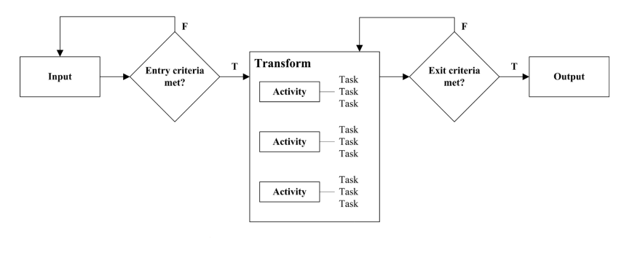
Software (Engineering) Process
A software process is a set of interrelated activities and tasks that transform input work products into output. Examples: requirement engineering, design, development, testing, etc.
Each process includes input (can be output of another process), transforming work activities and output.
A software process may include sub-processes. e.g. software requirement engineering include subprocess of requirement validation.
https://www.sixsigmadaily.com/input-output-model/

Slide 30
Summary
Software is code which is used to manage and control the hardware resources in a computer system and to simulate human tasks in faster and better-quality way.
There are about 8 levels of software applications.
Software has specific characteristics which makes it creation and application different to physical objects and also makes challenges in this industry.
To resolve mentioned challenges, it is important to have a systematic method to control the quality of software development and it is important for software developers to adhere to predefined code of ethics.
Software societies have adopted systematic methods to resolve software development challenges known as “Software Engineering”.
Software engineering is about a set of principles, methods, processes and procedures, management skills, etc in order to develop high quality software.

Slide 31
Quiz
False or Ture?
Software acts as an intermediary between an organisation and stored information”
Software is a virtual thing, making its requirement analysis easy.
Software engineering is a set of fix practices and actions for software development that can be adopted in any project
Fill the blanks:
Siri is a type of ---------------------- software
One of the major challenges in software maintenance is due to ----------
LOC is a method for ----------.
Any software process includes stages of ------------, ---------------and ------------

Slide 32
The Unit Roadmap – Next Lesson
Topic 1: Introduction to Software Engineering Unit
Topic 2: Introduction to Software Engineering Key Practices and Principles
Topic 3: Software Development Life Cycle Models
Topic 4: Requirement Engineering
Topic 5: System Modelling & Design
Topic 6: Software Implementation & Testing
Topic 7: System Dependency & Security
Topic 8: Project Management
Topic 9: Mini Project 1
Topic 10: Mini Project 2
Topic 11: Mini Project 3
Topic 12: Mini Project 4

Slide 33
Next Session
Topic 2: Introduction to Software Engineering Key Practices and Principles
Describe the software product lifecycle
Explain why alternative software development lifecycles have been developed
Discuss the role of requirements engineering, system modelling, testing, maintenance, reuse, project management, cyber security in software engineering.

Slide 34
References
Mohapatra, P.K.J. (2000). Software Engineering: (a Lifecycle Approach).
Sommerville, I., 2016. Software engineering (ed.). America: Pearson Education Inc.
Gotterbarn, D., Miller, K. and Rogerson, S., 1997. Software engineering code of ethics. Communications of the ACM, 40(11), pp.110-118.
Keller P. and Pyzdek T., (2013) The Handbook for Quality Management, McGraw-Hill
Pressman R (2010), Software Engineering 7th ed. McGraw-Hill
Van Scoy, R.L (1992) Software Development Risk: Opportunity, Not Problem. Software Engineering Institute
Guide to the Software Engineering Body of Knowledge SWEBOK ® A Project of the IEEE Computer Society. (n.d.).
‌

Slide 35
Topic 1– Introduction to The Software Engineering Unit
Any Questions?
Notes:
NCC Education - End Slide Master

